Slide 1
Array and Multiset Types in SQL
Example of array and multiset declaration:
create type Publisher as
(name varchar(20),
branch varchar(20))
create type Book as
(title varchar(20),
author-array varchar(20) array [10],
pub-date date,
publisher Publisher,
keyword-set varchar(20) multiset )
create table books of Book
Similar to the nested relation books, but with array of authors
instead of set

Slide 2
Creation of Collection Values
Array construction
array [‘Silberschatz’,`Korth’,`Sudarshan’]
Multisets
  multisetset [‘computer’, ‘database’, ‘SQL’]
To create a tuple of the type defined by the books relation: (‘Compilers’, array[`Smith’,`Jones’],
Publisher (`McGraw-Hill’,`New York’), multiset [`parsing’,`analysis’ ])
To insert the preceding tuple into the relation books
insert into books
values
(‘Compilers’, array[`Smith’,`Jones’],
Publisher (`McGraw-Hill’,`New York’), multiset [`parsing’,`analysis’ ])

Slide 3
Querying Collection-Valued Attributes
To find all books that have the word “database” as a keyword,
select title
from books
where ‘database’ in (unnest(keyword-set ))
We can access individual elements of an array by using indices
  E.g.: If we know that a particular book has three authors, we could write:
select author-array[1], author-array[2], author-array[3]
from books
where title = `Database System Concepts’

Slide 4
To get a relation containing pairs of the form “title, author-name” for each book and each author of the book
select B.title, A.author
from books as B, unnest (B.author-array) as
A (author )
To retain ordering information we add a with ordinality clause
select B.title, A.author, A.position
from books as B, unnest (B.author-array) with
ordinality as A (author, position )

Slide 5
Unnesting
The transformation of a nested relation into a form with fewer (or no) relation-valued attributes us called unnesting.
E.g.
select title, A as author, publisher.name as pub_name,
publisher.branch as pub_branch, K.keyword
from books as B, unnest(B.author_array ) as A (author ),
unnest (B.keyword_set ) as K (keyword )

Slide 6
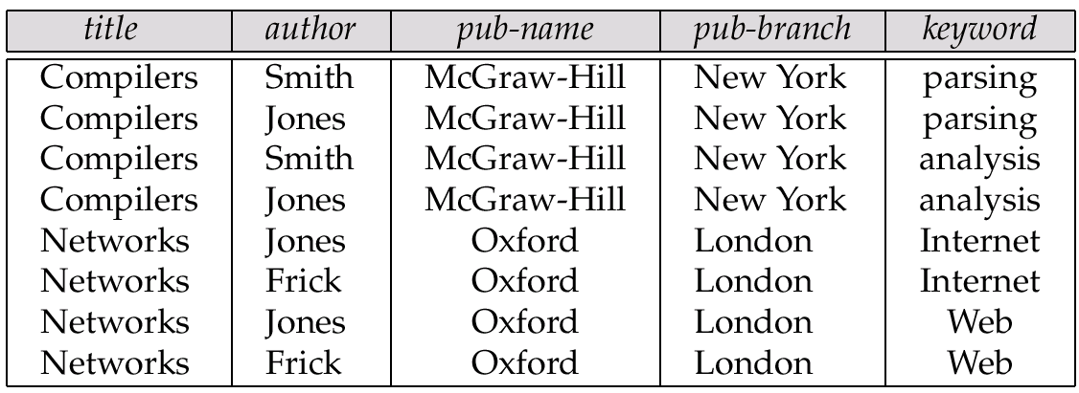
1NF Version of Nested Relation
1NF version of books
flat-books

Slide 7
Nesting
Nesting is the opposite of unnesting, creating a collection-valued attribute
Nesting can be done in a manner similar to aggregation, but using the function colect() in place of an aggregation operation, to create a multiset
To nest the flat-books relation on the attribute keyword:
select title, author, Publisher (pub_name, pub_branch ) as publisher,
collect (keyword) as keyword_set
from flat-books
groupby title, author, publisher
To nest on both authors and keywords:
select title, collect (author ) as author_set,
Publisher (pub_name, pub_branch) as publisher,
collect (keyword ) as keyword_set
from flat-books
group by title, publisher

Slide 8
Nesting (Cont.)
Another approach to creating nested relations is to use subqueries in the select clause.
select title,
array ( select author
from authors as A
where A.title = B.title order by A.position) as author_array,
Publisher (pub-name, pub-branch) as publisher,
multiset (select keyword
from keywords as K
where K.title = B.title) as keyword_set
from books4 as B

Slide 9
Definition of an object
Objects – User defined complex data types
An object has structure or state (variables) and methods (behavior/operations)
An object is described by four characteristics
Identifier: a system-wide unique id for an object
Name: an object may also have a unique name in DB (optional)
Lifetime: determines if the object is persistent or transient
Structure: Construction of objects using type constructors
Constructors
  Basic types
  Collection type: multiset, list, bag and array

Slide 10
Object Identifiers
Object identifiers used to uniquely identify objects
  Object identifiers are unique:
    no two objects have the same identifier
    each object has only one object identifier
  Can be
    system generated (created by database) or
    external (such as social-security number)
  System generated identifiers:
    Are easier to use, but cannot be used across database systems
    May be redundant if unique identifier already exists

Slide 11
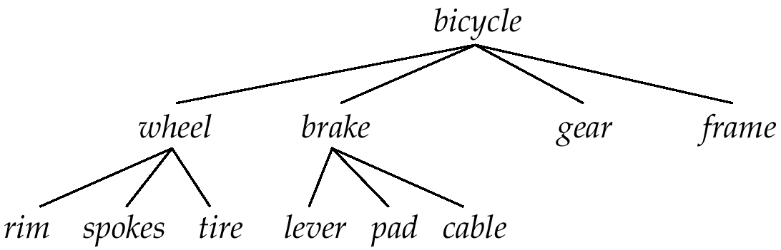
Object Containment
Each component in a design may contain other components
Can be modeled as containment of objects. Objects containing; other objects are called composite objects.
Multiple levels of containment create a containment hierarchy
  links interpreted as is-part-of, not is-a.
Allows data to be viewed at different granularities by different users.

Slide 12
Object Structure
An object has associated with it:
  A set of variables that contain the data for the object. The value of each variable is itself an object.
  A set of messages to which the object responds; each message may have zero, one, or more parameters.
  A set of methods, each of which is a body of code to implement a message; a method returns a value as the response to the message
The physical representation of data is visible only to the implementer of the object
The term message does not necessarily imply physical message passing. Messages can be implemented as procedure invocations.

Slide 13
Messages and Methods
Methods are programs written in general-purpose language with the following features
  only variables in the object itself may be referenced directly
  data in other objects are referenced only by sending messages.
Methods can be read-only or update methods
  Read-only methods do not change the value of the object
Strictly speaking, every attribute of an entity must be represented by a variable and two methods, one to read and the other to update the attribute
  e.g., the attribute address is represented by a variable address and two messages get-address and set-address.
  For convenience, many object-oriented data models permit direct access to variables of other objects.

Slide 14
Class Definition Example
class employee {
/*Variables */
string name;
string address;
date start-date;
int salary;
/* Messages */
int annual-salary();
string get-name();
string get-address();
int set-address (string new-address);
int employment-length();
};
Methods are defined separately
  E.g. int employment-length() { return today() – start-date;}
  int set-address(string new-address) { address = new-address;}

Slide 15
Object-Oriented Concepts
Abstract Data Types
  Class definition, provides extension to complex attribute types
Encapsulation
  Implementation of operations and object structure hidden
Inheritance
  Sharing of data within hierarchy scope, supports code reusability
Polymorphism
  Operator overloading

Slide 16
Inheritance
E.g., class of bank customers is similar to class of bank employees, although there are differences
  both share some variables and messages, e.g., name and address.
  But there are variables and messages specific to each class e.g., salary for employees and credit-rating for customers.
Every employee is a person; thus employee is a specialization of person
Similarly, customer is a specialization of person.
Create classes person, employee and customer
  variables/messages applicable to all persons associated with class person.
  variables/messages specific to employees associated with class employee; similarly for customer

Slide 17
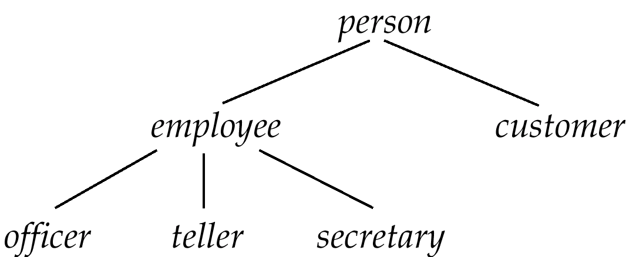
Inheritance (Cont.)
Place classes into a specialization
  variables/messages belonging to class person are inherited by class employee as well as customer
Result is a class hierarchy

Slide 18
Class Hierarchy Definition
class person{
string name;
string address:
};
class customer isa person {
int credit-rating;
};
class employee isa person {
date start-date;
int salary;
};
class officer isa employee {
int office-number,
int expense-account-number,
};
.
.
.

Slide 19
Class Hierarchy Example (Cont.)
Full variable list for objects in the class officer:
  office-number, expense-account-number: defined locally
  start-date, salary: inherited from employee
  name, address: inherited from person
Methods inherited similar to variables.
Substitutability — any method of a class, say person, can be invoked equally well with any object belonging to any subclass, such as subclass officer of person.
Class extent: set of all objects in the class. Two options:
  1. Class extent of employee includes all officer, teller and secretary objects.
  Class extent of employee includes only employee objects that are not in a subclass such as officer, teller, or secretary

